Slide 1
HR Analysis & Prediction

Slide 2

What is HR Analytics ?
HR Analytics helps us with interpreting organizational data. It finds out the people-related trends in the data and helps the HR Department take the appropriate steps to keep the organization running smoothly and profitably.

Slide 3

Lets jump into the details of our findings after analysis of an Sales organization data and the predictions we can made from that.

Slide 4
Job Roles in the Organization
In an organizations responsibilities and roles are divided into departments. There can be various types of roles based on qualification, Experience etc. Let’s take a Look at the various types of roles and amount of people working in that.

Slide 5
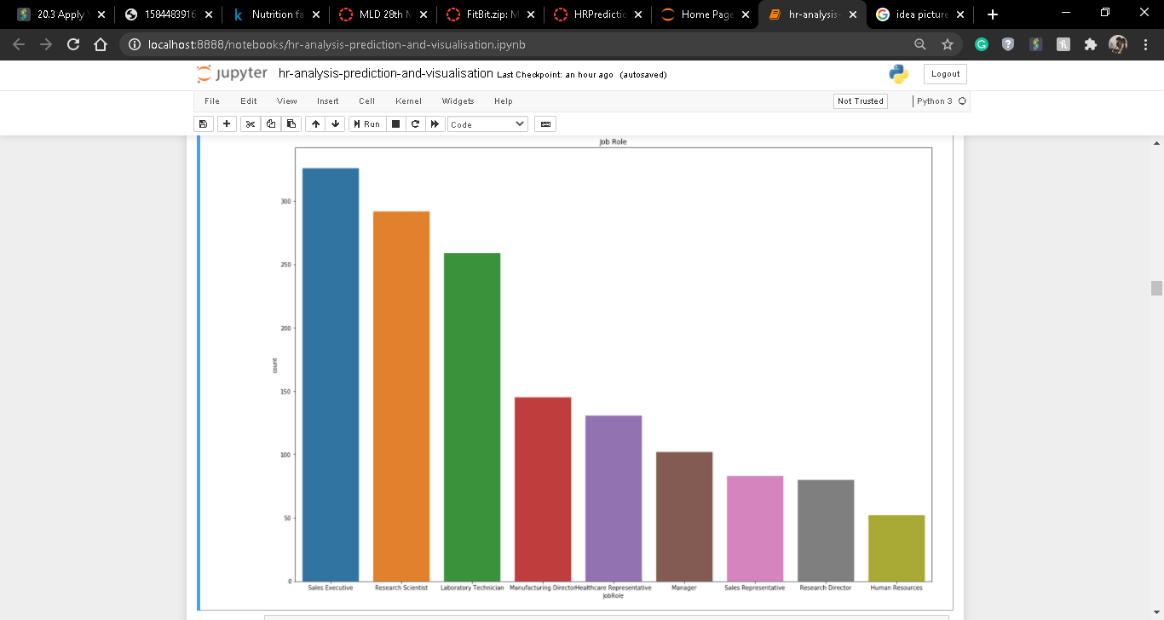

Slide 6
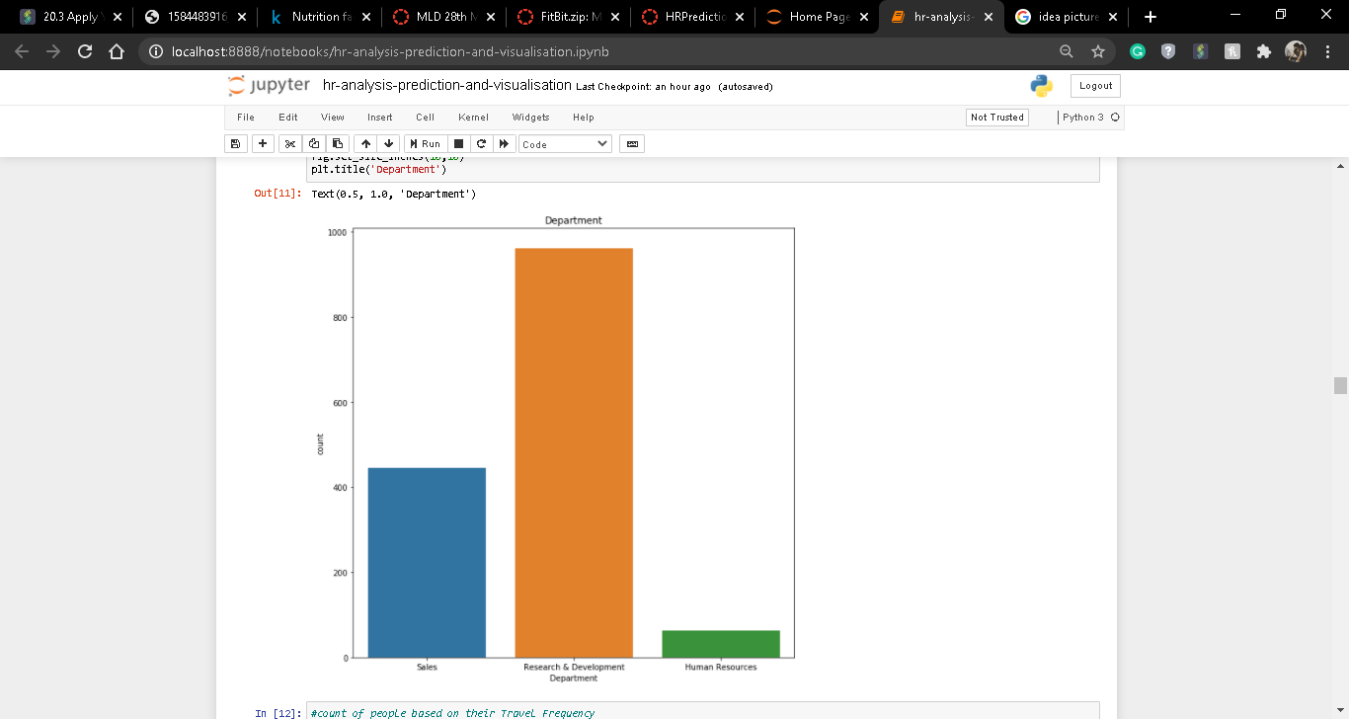

Slide 7
Here we can see various type of roles like Sales executive, Research Scientist, Manager, Human Resource etc.
In this organization we can see the most number of people are working in research and development and in Human Resource department least number of people are working.

Slide 8
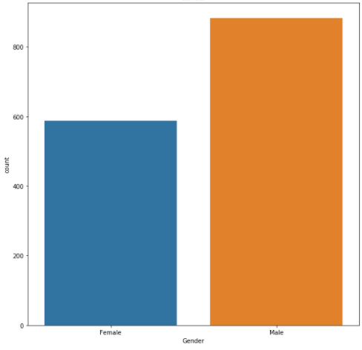
Male and Female Ratio
By comparing male and female ratio we can observe that male working ratio is higher than female working ratio.

Slide 9
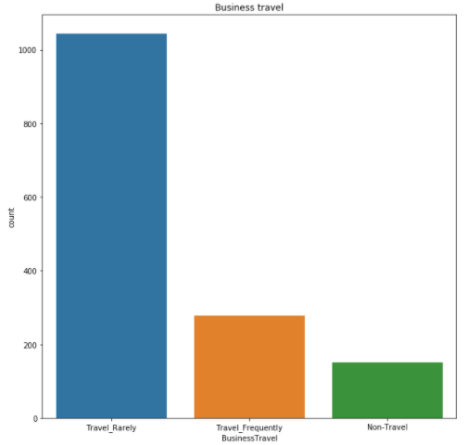
Travel Frequency
People of the organization may have to travel for work, for which expense for that have to pay by the organization. This the Business Travel Frequency of people based in the organization

Slide 10
people doing overtime
For the sake of the organization work, people have to do overtime work sometimes. Because of which companies might pay them extra money some times. Let us check which kind of people are more into doing overtime.

Slide 11
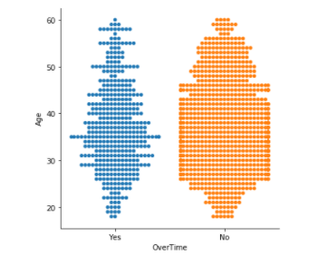

Slide 12
As we can see from the diagram most people are not into doing overtime for the organization and those people who do overtime, maximum of them fall in 30-45 years age spam. And for the people who are doing overtime organization may have to pay extra pay for their work.

Slide 13
Working Years & companies they have worked for
Based on years of experience and number of companies people have worked for pay roll may differ from person to person. So it’s an important aspect for the organization. Let’s see the experience of the employees and number of companies they have worked for.

Slide 14
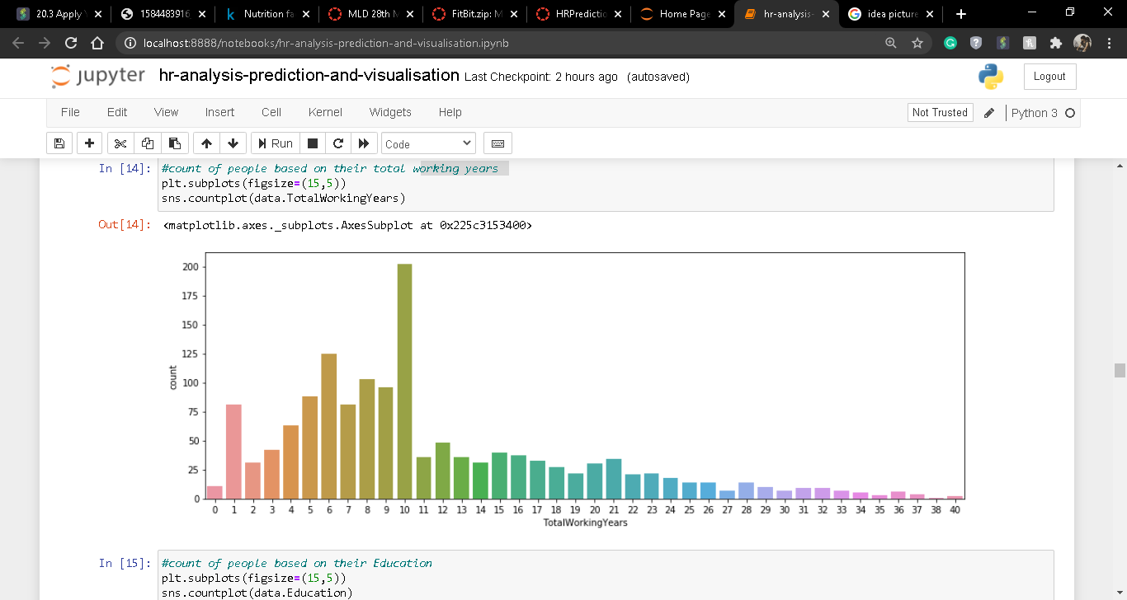

Slide 15
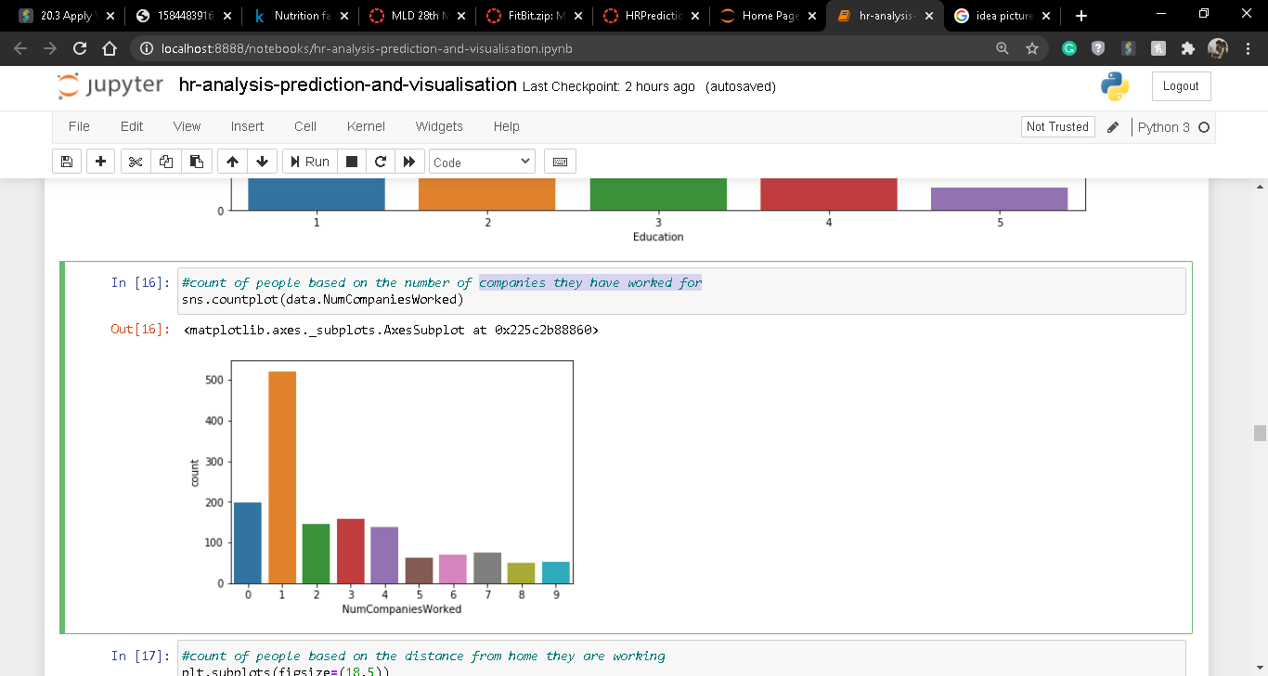

Slide 16
So based on the analysis we can see majority of the people are 5-10 years of experienced and majority of the people worked in 1 organization before.

Slide 17
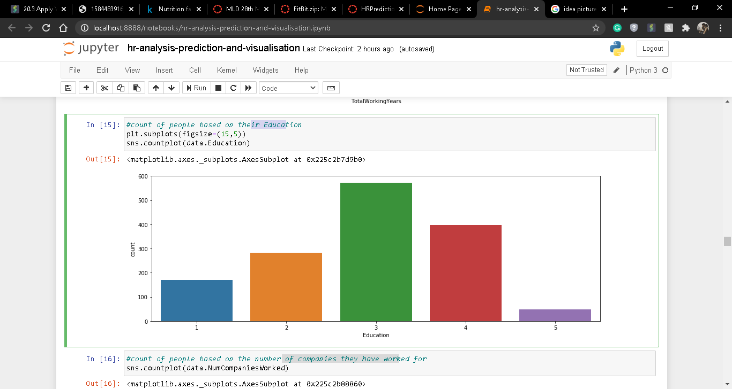
Education
Companies may have to offer LPA based on the education of the candidate also. More qualified the person, more chances of offering the role to that person and pay roll will vary on that. Here we can see in the organization most of the people have 3 certifications or degress.

Slide 18
Conclusions & Findings
Mentioned above points are most important and surely shall help the HR team to find a pattern or find and filter the criteria which are most responsible for attrition.

Slide 19
Thank you

